Slide 1
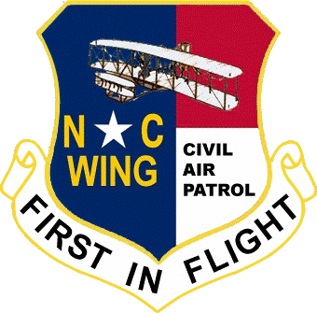
Civil Air Patrol Awards and Decorations
Compiled and presented by Capt Jim Thomasson MER-NC-001 / DP
8 August 2011

Slide 2
Civil Air Patrol Awards and Decorations
The awards and decorations of the Civil Air Patrol are designed to recognize . . .
Heroism
Service
Program achievements

Slide 3
Civil Air Patrol Awards and Decorations
In order to be considered for one of these awards, an individual . . .
Must be a member in good standing of the Civil Air Patrol at the time of the act being recognized
There is a statute of limitations for these awards and all recommendations must be submitted within 2 years of the act being performed.

Slide 4
Civil Air Patrol Awards and Decorations
Awards and Decorations ….
Are made to improve the esprit de corps of members.
Are all worn in the form of medals or ribbons and all are considered civilian decorations.
May only be worn and displayed on appropriate CAP uniforms.

Slide 5
Civil Air Patrol Awards and Decorations
It is possible for the next of kin of deceased persons to be presented awards to which a member was entitled, but which he or she did not receive
Award review boards are established at the region, wing, group, and squadron levels to consider recommendations for all awards and decorations.

Slide 6
Civil Air Patrol Awards and Decorations
Decorations
Any Civil Air Patrol member may initiate a recommendation for an award of a decoration.
Members initiating a recommendation must have knowledge of an act or service that merits recognition.
Awards concerning commanders must be initiated at a higher command level or by the appointing authority for National Executive Committee (NEC) members.

Slide 7
Civil Air Patrol Awards and Decorations
The authority to award decorations is vested in the NEC. The leader of the promotion and awards team of the NEC is authorized to approve all decorations in the name of the Committee.
The Silver Medal of Valor, the Bronze Medal of Valor, and the Distinguished Service Medal are exceptions to this and must be approved by the full committee.
Announcements of awarded decorations are made in personnel actions published by the CAP National Headquarters.

Slide 8
Civil Air Patrol Awards and Decorations
HOW TO WRITE A WINNING NOMINATION
Before writing the actual nomination narrative, take some time to think through your nomination. Your narrative should cover these aspects:
ACTIONS
RESULTS
IMPACT
PUBLIC RESPONSE

Slide 9
Civil Air Patrol Awards and Decorations
HOW TO WRITE A WINNING NOMINATION
ACTIONS
What was the overall mission, task or activity performed by the nominee?
Develop a strong opening paragraph where you describe the “general” nature of the ACTIONS and what were the events/situation that made these actions necessary.
List in either a chronological order or a logical order the actions taken.

Slide 10
Civil Air Patrol Awards and Decorations
HOW TO WRITE A WINNING NOMINATION
RESULTS
Following the sequences you developed in the ACTIONS section, describe the actual results of those actions.
Be concise …. Don’t ramble in your descriptions.
Don’t use broad generalizations that cannot be backed up.
Use quantitative terms and measurements wherever possible.
DON”T exaggerate or use excessive, flowery descriptions. As Jack Webb said on the TV series DRAGNET, “Give me the facts.”

Slide 11
Civil Air Patrol Awards and Decorations
HOW TO WRITE A WINNING NOMINATION
IMPACT
This is probably the most important part of the nomination! Take time to consider all aspects of this section.
Why were the actions necessary or needed?
Who was impacted by the member’s actions?
What (other than the people describe in Who) was impacted by the actions.

Slide 12
Civil Air Patrol Awards and Decorations
HOW TO WRITE A WINNING NOMINATION
PUBLIC RESPONSE
Did this event/action have a PIO?
How was the event/action publicized?
What was the overall public response to the event/action?
How were Civil Air Patrol’s missions enhanced by these actions? Is the event repeatable / can it be implemented by other units in other locations?

Slide 13
Civil Air Patrol Awards and Decorations
HOW TO WRITE A WINNING NOMINATION
Now, write a very strong closing statement. This paragraph should include the following aspects in a VERY brief form:
What actions were performed?
What were the results?
What was the impact of the actions?
What was the public response to the actions?
How were Civil Air Patrol missions enhanced?
And finally, the actual nominating statement.

Slide 14
Civil Air Patrol Awards and Decorations
Medal of Valor
Silver Medal of Valor Ribbon Bronze Medal of Valor Ribbon
The Medal of Valor is the highest decoration that can be awarded to members of the Civil Air Patrol.
The Silver Medal of Valor is awarded to active CAP members for "distinguished and conspicuous heroic action, at the risk of life, above and beyond the call of normal duty.”
The Bronze Medal of Valor is awarded to members for "distinguished and conspicuous heroic action where danger to self is probable and known.”
The Chairman of the National Awards Review Board is authorized to approve this medal for the National Executive Committee.

Slide 15
Civil Air Patrol Awards and Decorations
Distinguished Service Medal
Distinguished Service Medal ribbon
The Distinguished Service Medal of the Civil Air Patrol is awarded for "conspicuous performance of outstanding service in a duty of great responsibility where the position held and results obtained reflect upon the accomplishments and prestige of CAP on a national scale."
This is the highest award for service given by the CAP. Any member may nominate deserving cadets or officers for the award.

Slide 16
Civil Air Patrol Awards and Decorations
Distinguished Service Medal (CONT)
The duties for which this medal are awarded must be extremely difficult and of importance to the national mission of the CAP.
If the act of service is deemed to be important at the region level or wing level, the member is generally recommended for the Exceptional Service Award or the Meritorious Service Award.
All nominations are approved by the CAP National Headquarters.

Slide 17
Civil Air Patrol Awards and Decorations
Exceptional Service Award
Exceptional Service Award ribbon
The Exceptional Service Award is presented to Civil Air Patrol members who provide "exceptionally outstanding service to CAP...while serving in any capacity with CAP."
The award regulations make clear that the duty should carry the responsibility for completion of a major project at the region level or wing level.

Slide 18
Civil Air Patrol Awards and Decorations
Exceptional Service Award (Cont)
Any CAP member may nominate another cadet or officer for the Exceptional Service Award, but the duty must involve the fulfillment of a duty that greatly benefits the region or wing.
All nominations must be approved by the region commander.

Slide 19
Civil Air Patrol Awards and Decorations
The Meritorious Service Award is awarded for "outstanding achievement or meritorious service rendered specifically on behalf of CAP."
The regulations are quite clear that the simply performing one's normal duties very well will not automatically qualify a member for this award.

Slide 20
Civil Air Patrol Awards and Decorations
Meritorious Service Award (Cont)
This award is meant for "achievements and services which are clearly outstanding and unmistakably exceptional, though not worthy of the Distinguished Service Medal or the Exceptional Service Award”.
When the award is made to individuals who are part of an exceptionally successful group of CAP members, the regulation states that the Meritorious Service Award should be presented only to those members whose efforts were clearly integral to the success of the program.
All nominations for this award must be approved by the region commander.

Slide 21
Civil Air Patrol Awards and Decorations
Commander's Commendation Award
Commander's Commendation Award ribbon
The Commander's Commendation Award is presented to Civil Air Patrol members for "outstanding duty performance where achievements and services are clearly and unmistakably exceptional when compared to similar achievements and service of members of like rank and responsibility."

Slide 22
Civil Air Patrol Awards and Decorations
Commander's Commendation Award (Cont)
As in the case of the Meritorious Service Award, when an award is made to individuals who are part of an exceptionally successful group of CAP members, the regulation states that the Commander's Commendation Award should be presented only to those members whose efforts were clearly integral to the success of the program.
The Commander's Commendation Award differs from the Exceptional Service Award and the Meritorious Service Award in that the former does not require the performance "achievements and services significantly above and beyond normal duty performance."

Slide 23
Civil Air Patrol Awards and Decorations
Commander's Commendation Award (cont)
Nominations for this award may be approved by and the award may be presented by either a wing, region, or national commander. In each case, the award is slightly different depending on the authority by whom it is approved:
The basic ribbon is awarded to members who earn the award as authorized by their wing commander
A bronze star is added to the ribbon when the award is authorized by the region commander

Slide 24
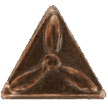
Civil Air Patrol Awards and Decorations
Commander's Commendation Award (cont)
A silver star is added to the ribbon when the award is authorized by the National Commander
If a CAP member is presented with multiple awards, a clasp is place to the left (from the point of view of the wearer) of a silver or bronze star.
Only one star of each type will be worn on this award.

Slide 25
Civil Air Patrol Awards and Decorations
CAP Achievement Award
Achievement Award ribbon
The intent of the award is to empower wing and group commanders with the ability to recommend and present achievement awards locally.
The official regulations state this the Achievement Award is "presented for outstanding service to the unit, group, or wing.”
The award may be approved by a group commander or, if a group structure does not exist for a given squadron, the wing commander may designate who has the authority to approve this award.

Slide 26
Civil Air Patrol Awards and Decorations
Certificate of Recognition for Lifesaving
Certificate of Recognition for Lifesaving ribbon
The Certificate of Recognition for Lifesaving is awarded to members of the Civil Air Patrol "who save a human life, but do not meet the criteria for the Bronze Medal of Valor or Silver Medal of Valor."
A member may be awarded this decoration for participation in a transport mission of either blood or organs, in which case he or she is presented with a basic ribbon and a certificate that accompanies the decoration.

Slide 27
Civil Air Patrol Awards and Decorations
Certificate of Recognition for Lifesaving (Cont)
A silver star is attached to the ribbon in recognition of lifesaving actions other than blood or organ transport if the actions do not meet the requirements of the higher awards.
Subsequent awards are denoted by the addition of bronze and silver clasps to the ribbon.
If more than three devices are authorized for wear on this ribbon, a second ribbon is worn to the left (from the point of view of the wearer) of the initial ribbon.

Slide 28
Civil Air Patrol Awards and Decorations
Certificate of Recognition for Lifesaving (Cont)
If future awards reduce the total number of devices to three the second ribbon is removed.
All nominations for this award must be approved by the relevant CAP wing commander.

Slide 29
Civil Air Patrol Awards and Decorations
National Commander’s Unit Citation Award
National Commander’s Unit Citation Award ribbon
The National Commander's Unit Citation Award is awarded to "units providing services or achievements above and beyond those normally recognized by a Unit Citation Award."
Awards are made at the sole discretion of the National Commander of the Civil Air Patrol.
The ribbon for the award is worn by all cadets and officers who were members of the unit during the time period for which the citation is awarded.

Slide 30
Civil Air Patrol Awards and Decorations
National Commander’s Unit Citation Award (Cont)
Once the award has been made, members may continue to wear the ribbon even if they transfer out of the unit at a later date.
Units that have been given the National Commander's Unit Citation Award are entitled to attach a streamer to the colors displayed at the unit's headquarters.

Slide 31
Civil Air Patrol Awards and Decorations
Unit Citation Award
Unit Citation Award ribbon
The Civil Air Patrol Unit Citation Award is presented for "exceptionally meritorious service or exceptionally outstanding achievement."
This service and achievement must be clearly above that which is performed by other similar units.
Members are awarded the Unit Citation Award ribbon if they were members of the unit during the time period for which the citation is awarded.

Slide 32
Civil Air Patrol Awards and Decorations
Unit Citation Award (Cont)
Units can be awarded this citation as a result of extended meritorious service over the course of at least one year, or in recognition of outstanding achievements in a single specific act or notable accomplishment that is separate and distinct from the normal mission or regular function of the unit.
The periods of an outstanding achievement are normally characterized by definite beginning and ending dates.
Units that have been given the Unit Citation Award are entitled to attach a streamer to the colors displayed at the unit's headquarters.

Slide 33
Civil Air Patrol Awards and Decorations
Senior Awards
Professional Development Awards
To accomplish its mission, the Civil Air Patrol requires an informed and active senior membership trained in leadership, management, and functional tasks.
The CAP Senior Member Professional Development Program prepares members to serve their units, their communities, and their nation.
The professional development ribbons are awarded by the Civil Air Patrol National Headquarters to denote the level of achievement that a senior member has achieved in this program.

Slide 34
Civil Air Patrol Awards and Decorations
The professional development program is divided into five levels:
Level One Foundations (no associated award)
Level Two Technical Training – Davis Award
Level Three Management – Loening Award
Level Four Command & Staff – Garber Award
Level Five Executive – Wilson Award

Slide 35
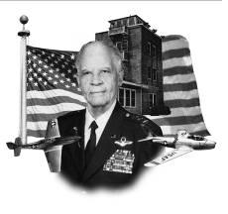
Civil Air Patrol Awards and Decorations
Benjamin O. Davis, Jr. Award
The Benjamin O. Davis, Jr. Award is presented to senior members who successfully complete the second level of professional development. It is named for Benjamin O. Davis, an aviation pioneer and commander of the Tuskegee Airmen during World War II.

Slide 36
Civil Air Patrol Awards and Decorations
Benjamin O. Davis, Jr. Award (Cont)
Members must complete the technical training required for the Leadership Award
Must attend Squadron Leadership School.
This course is designed "to enhance a senior member’s performance at the squadron level and to increase understanding of the basic function of a squadron and how to improve squadron operations."
There is (currently) no ribbon associated with this award and members receive a certificate.

Slide 37
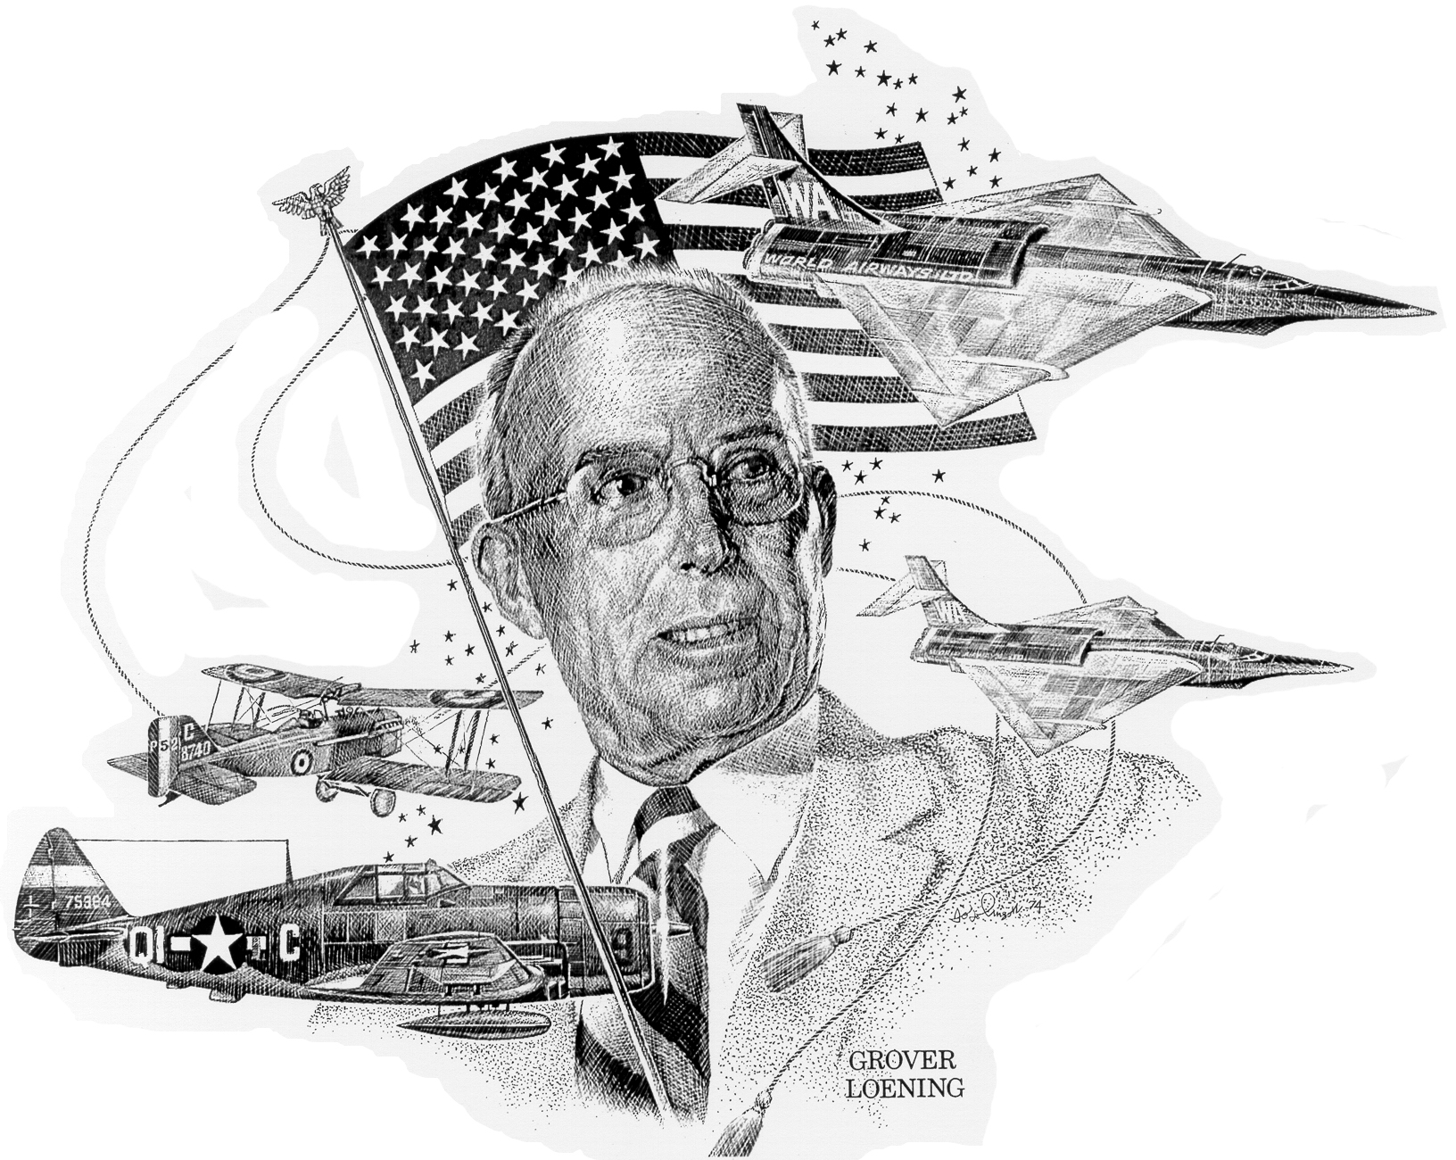
Civil Air Patrol Awards and Decorations
Grover Loening Aerospace Award
Grover Loening Aerospace Award ribbon
The Grover Loening Aerospace Award is presented to senior members who successfully complete the third level of the professional development program. The award is issued directly from CAP National Headquarters. The award is named for aerospace manufacturer Grover Cleveland Loening.

Slide 38
Civil Air Patrol Awards and Decorations
Grover Loening Aerospace Award (Cont)
This portion of the professional development program was designed for senior members serving as squadron, group, or wing commanders and for CAP staff officers.
In order to qualify for this award, members must:
Complete their level II training
Have one year of experience in a command or staff position
Attain a senior rating in any CAP specialty track
Attend two wing, region, or national conferences.
The Loening Award is a prerequisite for consideration for duty performance promotion to the grade of major in the Civil Air Patrol.

Slide 39
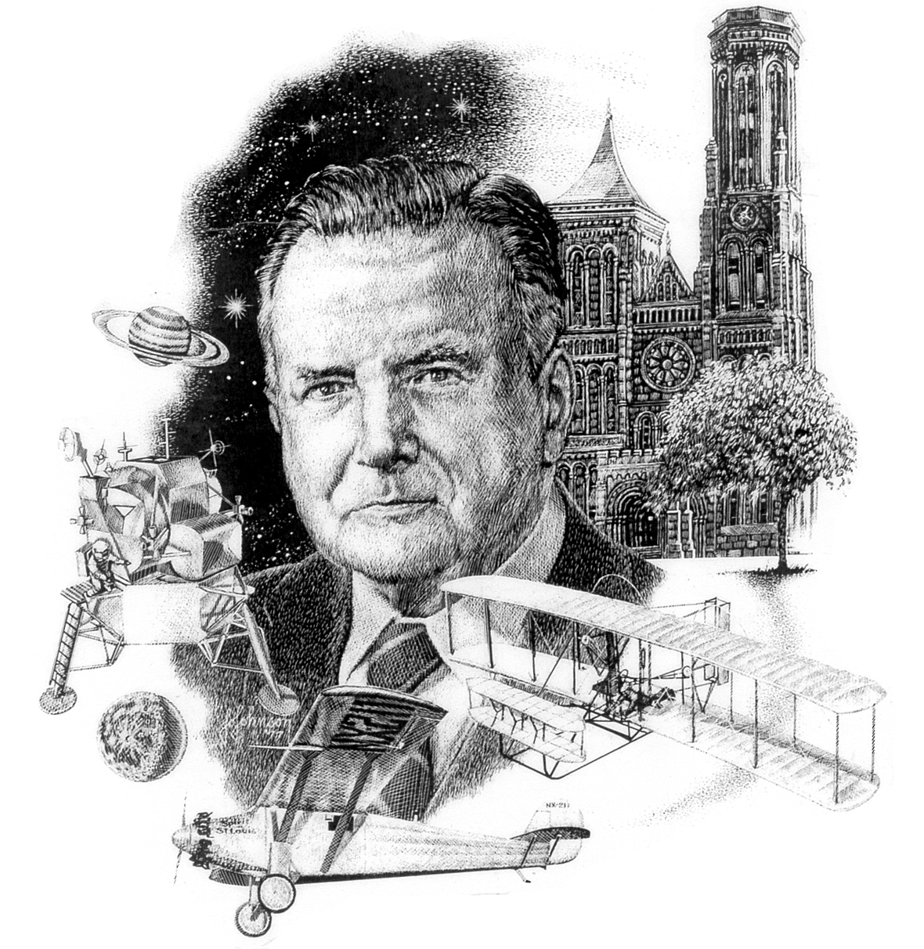
Civil Air Patrol Awards and Decorations
Paul E. Garber Award
Paul E. Garber Award ribbon
The Paul E. Garber Award is presented to Civil Air Patrol senior members who complete the level IV requirements of the Senior Member Professional Development Program. Like the Gill Robb Wilson Award, this is issued directly from CAP National Headquarters. The award is named after Paul Garber who served in both World War I and World War II before becoming the first curator of the National Air and Space Museum.

Slide 40
Civil Air Patrol Awards and Decorations
Paul E. Garber Award (Cont)
The Paul E. Garber Award is a prerequisite for any senior member to be considered for duty a performance promotion to the grade of Lieutenant Colonel in CAP.
This level of training concentrates on members desiring to become leaders within the CAP.
Every wing commander and region commander—and those members being groomed to replace them—is encouraged to complete the level IV training and earn the Paul E. Garber Award.
Members who complete Squadron Officer School are authorized to wear a bronze star on the award ribbon.

Slide 41
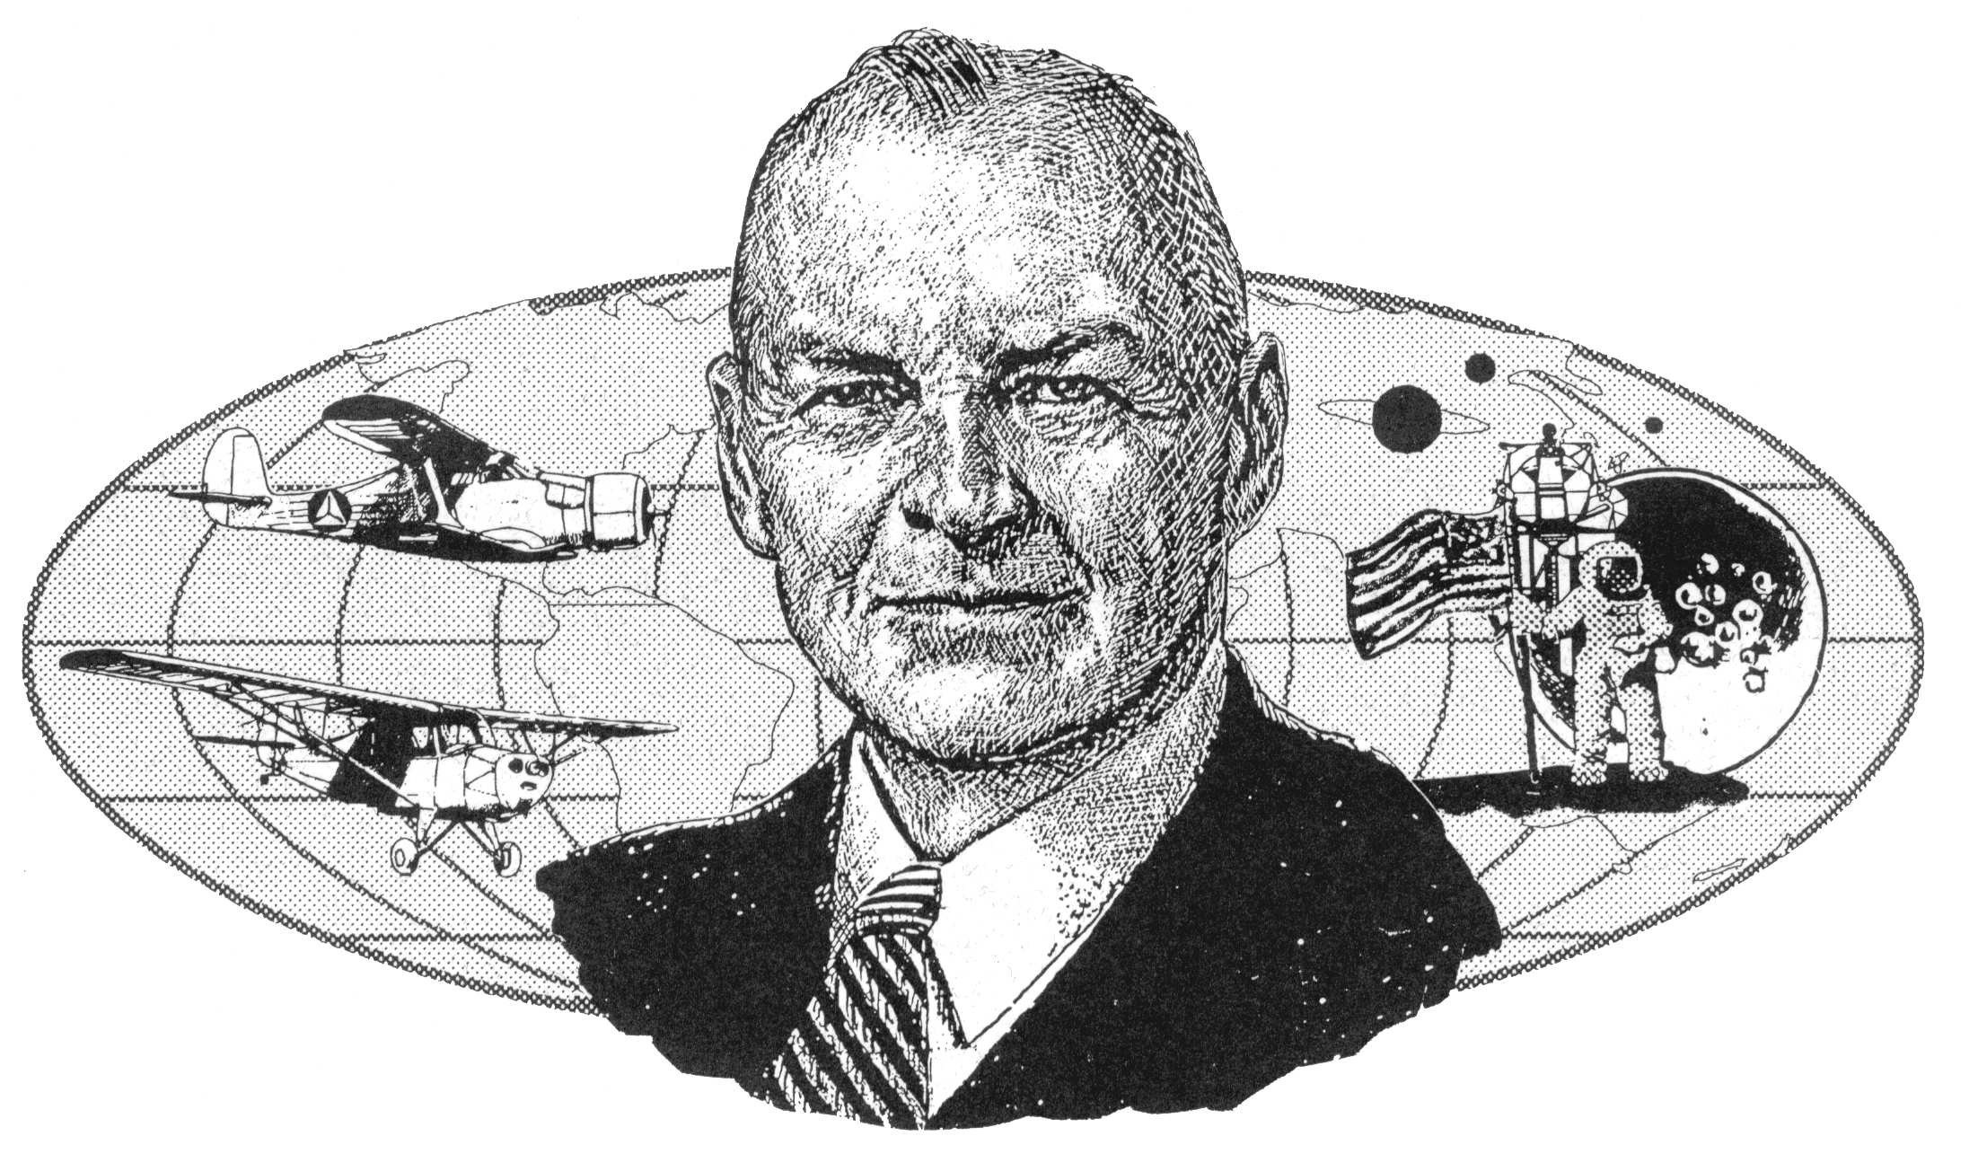
Civil Air Patrol Awards and Decorations
Gill Robb Wilson Award
Gill Robb Wilson Award ribbon
The Gill Robb Wilson Award was first implemented in 1964 to replace the National Commander’s Citation. It is named after Gill Robb Wilson, the first director of the CAP, and is presented to senior members who complete the fifth level of training in the Senior Member Professional Development Program.

Slide 42
Civil Air Patrol Awards and Decorations
Gill Robb Wilson Award (Cont)
This award is issued directly from the Civil Air Patrol National Headquarters and is the highest award in the professional development program.
This level of training is intended for those performing duty as commanders or staff officers. The training program concentrates on advanced leadership and management subjects.
Members who complete Air Command and Staff College are authorized to wear a bronze star on the award ribbon.
Members who complete the Air War College are authorized to wear a silver star on the award ribbon, which replaces the bronze star so that only one device is worn on the ribbon.

Slide 43
Civil Air Patrol Awards and Decorations
Leadership Award
The Leadership Award is presented to senior CAP members who complete training to earn a technician rating in one of 26 specialty tracks.
If members obtain a senior rating in a specialty track, they are authorized to wear a bronze star on the Leadership Award ribbon.
A silver star is awarded for a master rating.

Slide 44
Civil Air Patrol Awards and Decorations
Membership Award
Membership Award ribbon
The most basic professional development award in the CAP program is the Membership Award.
This award is presented to any senior member that successfully completes the level I Orientation Course.
Completion of the Orientation Course and the qualification for the Membership Award, is a prerequisite for participation in most areas of the Civil Air Patrol mission and for duty performance promotion to Second Lieutenant in the CAP.

Slide 45
Civil Air Patrol Awards and Decorations
Membership Award (Cont)
There are four modules required for completion of this level.
Basic Foundations Course
Cadet protection program training
Operations security awareness training
Equal opportunity training
The intent of this level I training "is to provide new members the information they need to begin their service in CAP successfully."

Slide 46
Civil Air Patrol Awards and Decorations
Aerospace Education Awards
The aerospace education awards (Yeager and Crossfield) are presented to senior members who excel in furthering the educational aspects of the Civil Air Patrol's mission.
These two awards are made to recognize completion of steps in the professional development program related specifically to aerospace education.

Slide 47
Civil Air Patrol Awards and Decorations
A. Scott Crossfield Award
A. Scott Crossfield Award Ribbon
The A. Scott Crossfield Award is named after American naval officer and test pilot Albert Scott Crossfield. The award is made by the Civil Air Patrol national headquarters.
The A. Scott Crossfield Award is presented to members who have:
Earned the master level rating in the aerospace education specialty track
Served as aerospace education officer.

Slide 48
Civil Air Patrol Awards and Decorations
Brigadier General Charles E. “Chuck” Yeager Aerospace Education Achievement Award
Brigadier General Charles E. “Chuck” Yeager Aerospace Education Achievement Award ribbon
The Brigadier General Charles E. “Chuck” Yeager Aerospace Education Achievement Award is presented to senior members who successfully complete the Civil Air Patrol's Aerospace Education Program for Senior Members (AEPSM).

Slide 49
Civil Air Patrol Awards and Decorations
Brigadier General Charles E. “Chuck” Yeager Aerospace Education Achievement Award (Cont)
This award is named for retired United States Air Force major general and noted test pilot, Charles E. “Chuck” Yeager
This is assessed through a test that senior members may complete online or using traditional means.
Upon validation of the test results, a certificate is issued by the member's wing.

Slide 50
Civil Air Patrol Awards and Decorations
Emergency Services Ribbons
Rescue "Find" Ribbon
Find ribbon
The Rescue Find Ribbon is awarded to any CAP member by his or her wing commander for making a find (distress or non-distress) on a search and rescue mission.
Take notes, this one is complicated!

Slide 51
Civil Air Patrol Awards and Decorations
Rescue "Find" Ribbon (Cont)
A distress find involves a downed aircraft or persons in distress.
Normally, a definite search objective must have been assigned, located, and positively identified.
Other finds are classified as non-distress; such as locating a non-distress emergency locator transmitter.
The basic ribbon is awarded for a first find (distress or non-distress).
A bronze clasp is awarded for each additional distress find or for each additional 20 non-distress finds.

Slide 52
Civil Air Patrol Awards and Decorations
Rescue "Find" Ribbon (Cont)
Both aircrew and ground team members may receive credit for finds. The "Find" Ribbon may also be painted on the aircraft in which the find was made.
1. Finds for the United States Coast Guard. Exceptions to the above criteria may be made for finds accomplished during missions conducted in concert with the USCG or USCG Auxiliary. The bulk of this joint effort consists of CAP flying patrol missions commonly referred to as a “sundown patrol.” When a CAP member or crew locates a boat or persons in distress and is instrumental in their discovery, credit for a distress find may be granted and a “find” ribbon awarded, provided the effort is classified as an assist by the USCG.

Slide 53
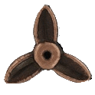
Civil Air Patrol Awards and Decorations
Rescue "Find" Ribbon (Cont)
2. Finds by Aircrew Members. In case of a search and rescue find by aircraft, a ribbon will be awarded to all crew members.
A bronze three-bladed propeller device is also worn on the ribbon for finds as aircrew members.
This applies to both “find and rescue” operations and “find and report” operations.
For example, when the search objective is sighted, rescue by aircraft may be impossible so the crew reports the find by relaying the information to an official ground station

Slide 54
Civil Air Patrol Awards and Decorations
Rescue "Find" Ribbon (Cont)
3. Finds by Ground Personnel. If the find is made by search and rescue ground teams, the ribbon will be awarded to all members of the team which locates the objective. Ground personnel are not awarded the propeller clasp.

Slide 55
Civil Air Patrol Awards and Decorations
Rescue "Find" Ribbon (Cont)
4. Combined Participation. Members who earn the ribbon as aircrew are identified by the bronze propeller attached to the ribbon.
If the same individual earns a clasp as a ground member makes a find, they are authorized to attach the clasp to the same ribbon with the bronze propeller.
This also applies to the individual who initially earns the Search “Find” Ribbon as a member of a ground search party and at some later date makes a find as an aircrew member. The member is then authorized to attach the bronze propeller to the ribbon.

Slide 56
Civil Air Patrol Awards and Decorations
Air Search and Rescue Ribbon
The Air Search and Rescue Ribbon is awarded to members who actively participate in at least 10 search and rescue sorties, with a bronze clasp awarded for each additional 10 sorties. All sorties must be in support of an actual search and rescue mission authorized through appropriate authorities.
1. Aircrew Members. A bronze three-bladed propeller device will be worn centered on Air Search and Rescue Ribbons earned as aircrew members. Credit will be given for participation in flights as either pilot or observer.

Slide 57
Civil Air Patrol Awards and Decorations
Air Search and Rescue Ribbon (Cont)
Ground Personnel. Credit given will be computed on the basis of time spent on a mission and the nature of the duties performed.
Ground personnel performing hazardous duties, such as ground rescue or ground search, may be credited with one sortie for each 4 hours of actual participation, not to exceed three sorties in any 24-hour period.
Ground personnel performing non-hazardous duties, such as base support or staff functions, may be credited with one sortie for each 8 hours of participation, not to exceed two sorties for any 24-hour period.

Slide 58
Civil Air Patrol Awards and Decorations
Air Search and Rescue Ribbon (Cont)
3. Combined Participation. Members who earn the Air Search and Rescue Ribbon as an aircrew member are identified by attaching a bronze propeller to the ribbon.
If the same individual earns clasps as a ground member of searches or missions, they are authorized to attach the clasps to the same ribbon with the bronze propeller.
This also applies to the individual who initially earned the Air Search and Rescue Ribbon as a member of a ground search party and later participates in enough searches as an aircrew member.

Slide 59
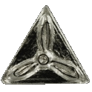
Civil Air Patrol Awards and Decorations
Air Search and Rescue Ribbon (Cont)
Additional clasps are placed so that the ribbon will have a balanced appearance, with bronze propeller(s) in the middle of the ribbon.
A silver clasp is used in place of 5 bronze clasps for members who have participated in 50 additional sorties.

Slide 60
Civil Air Patrol Awards and Decorations
Counterdrug Ribbon
The Counterdrug Ribbon is awarded to Senior Members for participation in 10 counterdrug sorties.
A bronze clasp is awarded for each additional 10 sorties, and replaced by a silver clasp after 50 additional sorties.
Cadets are prohibited from participating in Counterdrug operations.
Although similar in appearance, this award is not to be confused with the Navy/Marine Corps Commendation Medal.

Slide 61
Civil Air Patrol Awards and Decorations
Disaster Relief Ribbon
The Disaster Relief Ribbon is awarded for:
Participation in five disaster relief missions
And completion of two designated disaster relief training courses.
The ribbon may also be awarded for:
Completion of one disaster relief course and 40 hours of disaster relief training or operations. Participation must be verified by the on-scene commander.

Slide 62
Civil Air Patrol Awards and Decorations
Disaster Relief Ribbon (Cont)
The Disaster Relief Ribbon may be awarded with a Silver "V" device
to any CAP member who participates as a CAP member in a disaster relief effort for a Presidential declared disaster. Participation in any Presidential declared disaster since 1990 qualifies.

Slide 63
Civil Air Patrol Awards and Decorations
Service Ribbons
Command Service Ribbon
Awarded to Senior Members who have served at least 1 year continuous service as commander — squadron, group, wing, etc.
The basic ribbon is awarded for service as a squadron commander.
A bronze star is added to denote service as group commander
A silver star for wing commander
A gold star for region commander service.
Two gold stars will be used to denote service as National Commander.
Only one level of command may be shown on the ribbon.

Slide 64
Civil Air Patrol Awards and Decorations
Red Service Ribbon
The Red Service Ribbon is given to any member of the Civil Air Patrol who has been a member of the program for two years (as a cadet or Senior Member in good standing.) In addition, the following devices are awarded for additional years of service:
A first Bronze Clasp is awarded at the end of 3 additional years (total of 5 years).
Additional Bronze Clasps are awarded for each additional 5 years of service
A maximum of 3 bronze clasps (denoting 15 years of service) will be worn.

Slide 65
Civil Air Patrol Awards and Decorations
Red Service Ribbon (Cont)
Longevity Devices: A metal number, denoting years of service, awarded at the end of 20 years and in increments of 5 years thereafter.
The longevity device is worn centered on the red service ribbon and the bronze clasps are no longer worn.

Slide 66
Civil Air Patrol Awards and Decorations
Community Service Award
Community service ribbon
The Community Service Ribbon is awarded to senior members and cadets who complete 60 hours of community service.
The community service is done outside of Civil Air Patrol, and is verified by somebody other than the member.
Civil Air Patrol headquarters has now authorized the wear of a bronze device for every additional 60 hours of community service.

Slide 67
Civil Air Patrol Awards and Decorations
Cadet Advisory Council Ribbon
The Cadet Advisory Council Ribbon is awarded to the primary members of an advisory council.
A shoulder cord is worn while that member is the primary representative, while the ribbon continues to be worn even after the cadet is no longer on the CAC.
The wear policy for the Cadet Advisory Council Ribbon was changed in 2007 to allow senior members who earned this ribbon as a cadet to continue wearing the ribbon with the appropriate clasp.

Slide 68
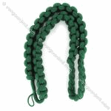
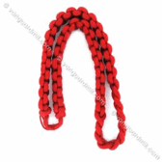
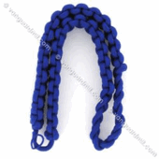
Civil Air Patrol Awards and Decorations
Cadet Advisory Council Ribbon (Cont)
GROUP LEVEL: The basic ribbon with no attachments and active CAC members wear a green shoulder cord.
WING LEVEL: The ribbon would have a bronze star attachment and active CAC members wear a red shoulder cord.
REGION LEVEL: The ribbon would have a silver star and active CAC members wear a blue shoulder cord.
NATIONAL LEVEL: The ribbon would have a gold star attached and active CAC members wear a gold shoulder cord.

Slide 69
Civil Air Patrol Awards and Decorations
Programs Ribbons
These ribbons are awarded to members for participating in or providing leadership for National Cadet Special Activities.
Encampment Ribbon
The Encampment Ribbon is awarded to all cadets who complete a Civil Air Patrol Encampment successfully. It is also awarded to cadet staff members and officers who provide leadership for the encampment.

Slide 70
Civil Air Patrol Awards and Decorations
Encampment Ribbon (Cont)
Multiple encampments are symbolized with bronze clasps, one per additional encampment and worn centered on the encampment ribbon.
Cadet encampments, usually a week in length, provide cadets with an intense look at military life.
Encampment attendance is a prerequisite for the Gen. Billy Mitchell Award.
Senior members may also be awarded the ribbon for providing leadership at CAP encampments.

Slide 71
Civil Air Patrol Awards and Decorations
Cadet Special Activities Ribbon
Awarded to cadets and officers who participate in National Cadet Special Activities.
Officer participants must be identified by the Civil Air Patrol project officer and approved by the member’s region commander.
Each subsequent activity is represented by a bronze star affixed to the basic ribbon.
Cadets earning this ribbon may continue to wear the ribbon as a Senior Member.

Slide 72
Civil Air Patrol Awards and Decorations
National Cadet Competition Ribbon
Awarded to cadets for participation as a team member in the National Cadet Competition.
The basic ribbon will be worn by the winner of the wing competition and/or cadets selected to represent the wing at a region competition.
A bronze star will be affixed for the winners of the region competition
A silver star will be worn by the sweepstakes winners of the national competition.

Slide 73
Civil Air Patrol Awards and Decorations
National Cadet Competition Ribbon (Cont)
Repetitive awards may be recognized by wearing additional stars in the appropriate competition level.
Officers who earned this ribbon as a cadet may continue to wear the ribbon.
Officers who act as official escorts to the above-mentioned championship teams may also wear the ribbon.

Slide 74
Civil Air Patrol Awards and Decorations
National Cadet Color Guard Competition Ribbon
Awarded to cadets for participation as a team member in the National Color Guard Competition.
The basic ribbon will be worn by the winner of the wing competition and/or cadets selected to represent the wing at a region competition.
A bronze star will be affixed for the winners of the region competition
A silver star will be worn by the sweepstakes winner of the national competition.

Slide 75
Civil Air Patrol Awards and Decorations
National Cadet Color Guard Competition Ribbon (Cont)
Repetitive awards may be recognized by wearing additional stars in the appropriate competition level.
Officers who act as official escorts to the above mentioned championship teams may also wear the ribbon.
Senior Members who earned this ribbon as a cadet may continue to wear the ribbon.

Slide 76
Civil Air Patrol Awards and Decorations
International Air Cadet Exchange Ribbon
Awarded to cadets and officer escorts participating in the International Air Cadet Exchange (IACE) outside the continental limits of the United States.
IACE is a program open to Cadets 17 or older who have earned the Earhart Award (Cadet Captains and above) to visit participating foreign countries.

Slide 77
Civil Air Patrol Awards and Decorations
Cadet Achievement Awards
These awards are given to cadets who pass their unit tests, and also accompany an advancement in grade.
Cadets who become Senior Members may wear only their highest ranking cadet achievement ribbon on their senior member uniform.

Slide 78
Civil Air Patrol Awards and Decorations
General Carl A. Spaatz Award
Carl A. Spaatz ribbon
The General Carl A. Spaatz Award is the highest award in the Civil Air Patrol Cadet Program.
The award honors General Carl A. Spaatz, who was the first Chief of Staff of the United States Air Force and the second National Commander of the Civil Air Patrol.

Slide 79
Civil Air Patrol Awards and Decorations
General Carl A. Spaatz Award (Cont)
The Spaatz Award may be awarded to cadets who "successfully complete all phases of the CAP cadet program and the General Carl A. Spaatz Award examination" consisting of:
A comprehensive leadership and aerospace education written examination
A graded essay and
A physical fitness test.
The Spaatz Award is arguably the most difficult honor to earn in the CAP cadet program.
Cadets earning Spaatz Award are also promoted to Cadet Colonel, the highest grade obtainable in the cadet program.

Slide 80
Civil Air Patrol Awards and Decorations
General Carl A. Spaatz Award (Cont)
Upon reaching the age of 21, Cadet Colonels are eligible to transfer to the Civil Air Patrol Officer program with appointment to the grade of Captain.
Cadet Colonels who voluntarily transfer to the Officer program between the ages of 18 and 21 receive the grade Senior Flight Officer.
By regulation, this award should be presented by a military or CAP general officer, governor, congressman, federal judge, or a cabinet-level official.

Slide 81
Civil Air Patrol Awards and Decorations
General Ira C. Eaker Award
The General Ira C. Eaker Award is given by the Civil Air Patrol in honor of the former Deputy Commander U.S. Army Air Forces and aviation pioneer.
It is presented on behalf of CAP by CAP National Headquarters to cadets who have completed the specific requirements in the Phase IV of the cadet program.
The award is accompanied by promotion to the grade of Cadet Lieutenant Colonel.
By regulation, this award should be presented by a region commander (or designee) or higher, a governor, congressman, federal judge, official appointed to a federal office, or a military officer in the rank of colonel (or the equivalent) or above.

Slide 82
Civil Air Patrol Awards and Decorations
Amelia Earhart Award
Amelia Earhart Ribbon
The Amelia Earhart Award is a cadet achievement of the Civil Air Patrol presented in honor of Amelia Earhart, pioneering aviatrix and aviation record-setter.
This award is presented on behalf of CAP National Headquarters to denote the successful completion of the specific requirements in Phase III of this program.
Cadets receiving the Earhart Award are promoted to Cadet Captain.
By regulation, this award should be presented by a wing commander (or designee) or higher, an official appointed to a state or federal office, or a state legislator or state judge.

Slide 83
Civil Air Patrol Awards and Decorations
General Billy Mitchell Award
Billy Mitchell ribbon
The General Billy Mitchel Award is earned by Civil Air Patrol cadets who have successfully completed the second phase of the cadet program. The award is given in honor of Maj Gen William "Billy" Mitchell, former Deputy Chief of the Army Air Service and military aviation visionary.

Slide 84
Civil Air Patrol Awards and Decorations
General Billy Mitchell Award (Cont)
This award marks the end of the enlisted phase of the cadet program
Cadets are promoted to Cadet Second Lieutenants upon receipt and, by extension, Cadet Officers.
In order to earn this award, cadets must pass a series of leadership, aerospace and physical fitness tests and attend moral leadership training for each achievement from Cadet Airman Basic through Cadet Chief Master Sergeant.

Slide 85
Civil Air Patrol Awards and Decorations
General Billy Mitchell Award (Cont)
In addition, cadets must attend a military-style encampment before this award is made, and have maintained active membership in the Civil Air Patrol for at least 18 months since joining.
15% of Civil Air Patrol cadets achieve the Mitchell Award.

Slide 86
Civil Air Patrol Awards and Decorations
General Billy Mitchell Award (Cont)
Mitchell Cadets who chose to enlist in the United States Air Force or the United States Coast Guard are promoted to E-3 upon enlistment and completion of Basic Military Training (BMT), instead of E-1.
Mitchell Cadets who enlist in the Marine Corps, Navy, or Army are promoted to E-2 upon completion of BMT.
A silver star is worn on the ribbon to denote successful completion of Cadet Officer School.
By regulation, this award should be presented by a group commander (or higher), the wing director of cadet programs, a state or federal official, or an elected local official.

Slide 87
Civil Air Patrol Awards and Decorations
Neil Armstrong Achievement
Neil Armstrong Ribbon
The Neil Armstrong Achievement is awarded for successfully completing the specific requirements of Achievement 8 in Phase II of the Civil Air Patrol cadet program.
Awarded for the second achievement of Chief Master Sergeant.

Slide 88
Civil Air Patrol Awards and Decorations
Dr. Robert H. Goddard Achievement
Robert H. Goddard ribbon
The Dr. Robert H. Goddard Achievement is awarded for successfully completing the specific requirements of Achievement 7 in Phase II of the Civil Air Patrol cadet program.
Accompanies promotion to Cadet Chief Master Sergeant
NOTE: A silver star worn on the ribbon denotes successful completion of the Model Rocketry Badge requirements (if Mitchell Award has been earned).

Slide 89
Civil Air Patrol Awards and Decorations
General Jimmy Doolittle Achievement
Jimmy Doolittle Ribbon
The General Jimmy Doolittle Achievement is awarded for successfully completing the specific requirements of Achievement 6 in Phase II of the Civil Air Patrol cadet program.
Accompanies promotion to Cadet Senior Master Sergeant

Slide 90
Civil Air Patrol Awards and Decorations
Charles A. Lindbergh Achievement
Charles A. Lindbergh Ribbon
The Charles A. Lindbergh Achievement is awarded for successfully completing the specific requirements of Achievement 5 in Phase II of the Civil Air Patrol cadet program.
Accompanies promotion to the grade of Cadet Master Sergeant.

Slide 91
Civil Air Patrol Awards and Decorations
Captain Eddie Rickenbacker Achievement
Eddie Rickenbacker Ribbon
The Captain Eddie Rickenbacker Achievement is awarded for successfully completing the specific requirements of Achievement 4 in Phase II of the Civil Air Patrol cadet program.
Accompanies promotion to the grade of Cadet Technical Sergeant

Slide 92
Civil Air Patrol Awards and Decorations
Wright Brothers Award
Wright Brothers Ribbon
The Wright Brothers Award is awarded for successfully completing the Phase I of the Civil Air Patrol cadet program.
Marks the transition of a cadet to the non-commissioned officer status in the Civil Air Patrol cadet program.
Accompanies promotion to the grade of Cadet Staff Sergeant.
(Prior to the creation of the Mary Feik Achievement in April 2003, the Wright Brothers award was the 3rd Achievement and accompanied promotion to the grade of Cadet Senior Airman.)

Slide 93
Civil Air Patrol Awards and Decorations
Mary Feik Achievement Award
Mary Feik ribbon
The Mary Feik Achievement is awarded for successfully completing the specific requirements of Achievement 3 in Phase I of the cadet program.
Accompanies promotion to the grade of Cadet Senior Airman.

Slide 94
Civil Air Patrol Awards and Decorations
General H. H. "Hap" Arnold Achievement
H. H. "Hap" Arnold ribbon
The General H. H. "Hap" Arnold Achievement is awarded for successfully completing the specific requirements of Achievement 2 in Phase I of the cadet program.
Accompanies promotion to the grade of Cadet Airman First Class.

Slide 95
Civil Air Patrol Awards and Decorations
General J. F. Curry Achievement Award
J. F. Curry Ribbon
The General J. F. Curry Achievement is awarded for successfully completing the specific requirements of Achievement 1 in Phase I of the cadet program.
Cadets must:
Successfully complete the Physical Fitness test
Leadership chapter 1
Have participated in at least 1 character development class.
Accompanies promotion to the grade of Cadet Airman.

Slide 96
Civil Air Patrol Awards and Decorations
Senior Member Awards
Cadet Orientation Pilot Ribbon
Awarded to members who provide 50 cadet orientation flights. Each cadet receiving credit for the flight, may be counted toward the total of 50.
A bronze clasp may be added for each additional 50 flights.

Slide 97
Civil Air Patrol Awards and Decorations
Cadet Awards
Air Force Association Award to the Aerospace Education Unit Cadet of the Year
AFA cadet of the year Ribbon
This award from the Air Force Association recognizes one outstanding cadet per unit each year.

Slide 98
Civil Air Patrol Awards and Decorations
Air Force Sergeants Association Award to the
Unit Cadet NCO of the Year
AFSA NCO Cadet of the Year Ribbon
The "Air Force Sergeants Association Award to Outstanding CAP Cadet Noncommissioned Officer of the Year. An annual award established by the Air Force Sergeants Association to recognize the outstanding CAP cadet NCO in each squadron.

Slide 99
Civil Air Patrol Awards and Decorations
VFW Award for Unit Cadet Officer of the Year
VFW Cadet Officer of the Year Ribbon
The Veterans of Foreign Wars recognize excellence in CAP cadet officers through an annual award to the outstanding cadet officer in each CAP squadron.
CAP squadron commanders may nominate one cadet officer each year for the award by submitting a nomination to the VFW detailing the cadet's accomplishments and certifying that cadet officer:

Slide 100
Civil Air Patrol Awards and Decorations
VFW Award for Unit Cadet Officer of the Year (Cont)
Is in good standing academically
Progressing satisfactorily in the CAP cadet program,
Demonstrated outstanding achievement in community service and the cadet program (aerospace and leadership).
Be of high moral character
Demonstrate a high level of professionalism in appearance and action and patriotism (commander or member of color guard, drill team, etc.)
Actively promotes Americanism
Demonstrates growth potential (assumes higher levels of responsibility).
A Cadet may only receive this award once.

Slide 101
Civil Air Patrol Awards and Decorations
VFW Award for Unit Cadet NCO of the Year
VFW Cadet NCO of the Year Ribbon
The VFW recognizes excellence in CAP cadet non-commissioned officers (NCO) through an annual award to the outstanding cadet NCO in each CAP squadron.
CAP squadron commanders may nominate one cadet NCO each year for the award by submitting a nomination to the VFW detailing the cadet's accomplishments and certifying that cadet officer:
Is in good standing academically
Progressing satisfactorily in the CAP cadet program
Demonstrates outstanding achievement in community service and the cadet program (aerospace and leadership).

Slide 102
Civil Air Patrol Awards and Decorations
VFW Award for Unit Cadet NCO of the Year (Cont)
Be of high moral character
Demonstrates a high level of professionalism in appearance and action and patriotism (commander or member of color guard, drill team, etc.)
Actively promotes Americanism
Demonstrates growth potential (assumes higher levels of responsibility).
A Cadet may only receive this award once.

Slide 103
Civil Air Patrol Awards and Decorations
Cadet Recruiter Ribbon
The Cadet Recruiter Ribbon is given to cadets who recruit two or more people into the Civil Air Patrol.
For each additional 2 members recruited, a bronze clasp may be worn on the ribbon.
Once a cadet earns 5 bronze clasps, they may be replaced with a silver clasp.
Bronze clasps are no longer worn after a silver clasp is received.
For every 10 new cadets recruited after this, an additional silver clasp may be worn on the ribbon.

Slide 104
Civil Air Patrol Awards and Decorations
Frank E. Borman Falcon Award (Obsolete)
Frank E. Borman Falcon Ribbon
The Frank E. Borman Falcon Award was awarded to former Cadets who completed the Spaatz Award and who took subsequent steps to become dynamic Americans and aerospace leaders. Specifically:
1) secured admission to any military service academy and successfully completed the second year of instruction,
2) Secured admission to advanced ROTC program of any service in an accredited college of university, or
3) Become an active Senior Member of CAP for at least one year and be recommended by the unit Commander.

Slide 105
Civil Air Patrol Awards and Decorations
Frank E. Borman Falcon Award (Cont)
This award was unique in that it is specifically authorized for award to non-CAP members: former Spaatz cadets who qualified based on their military training were encouraged to apply to Civil Air Patrol National Headquarters for the Falcon Award, even if they were no longer CAP members.
The Falcon Award was discontinued in 1979.
Senior Members who were awarded the Falcon Award may continue to wear it as their highest cadet award with their other ribbons.
Also, any Senior Member who was previously a CAP Cadet is authorized to wear the highest Cadet achievement award.

Slide 106
Civil Air Patrol Awards and Decorations
World War II ribbons
These ribbons were awarded to members for service as a member of the Civil Air Patrol during World War II. Members who have earned them may continue to wear them, although they are no longer awarded.
Wartime Service Ribbon
The Wartime Service Ribbon is awarded to CAP members who served during World War II in any one of several capacities. The ribbon replaces several specific World War II ribbons, which are listed in the following slides.

Slide 107
Civil Air Patrol Awards and Decorations
Anti-Submarine Coastal Patrol Ribbon (Obsolete)
The Anti-Submarine Coastal Patrol Ribbon was awarded to members who patrolled the Atlantic coast for enemy submarine attacks during World War II. This ribbon is no longer available, but is still worn by those who have earned it.

Slide 108
Civil Air Patrol Awards and Decorations
Southern Liaison Patrol Ribbon (Obsolete)
Southern Liaison Patrol Ribbon
The Southern Liaison Patrol Ribbon was awarded to members who patrolled the southern border of the United States. This ribbon is no longer available, but is still worn by those who earned it.

Slide 109
Civil Air Patrol Awards and Decorations
Tow-Target & Tracking Ribbon (Obsolete)
Tow-target & tracking ribbon
The Tow-Target & Tracking Ribbon was awarded to members who conducted reconnaissance missions for the U.S. Army Air Forces. This ribbon is no longer available, but is still worn by those who earned it.

Slide 110
Civil Air Patrol Awards and Decorations
Courier Ribbon (Obsolete)
The Courier Ribbon was awarded to members who served as public information officers. This ribbon is no longer available, but is still worn by those who earned it.

Slide 111
Civil Air Patrol Awards and Decorations
Forest Patrol Ribbon (Obsolete)
The Forest Patrol ribbon was awarded to members who patrolled the Northern United States border from enemy attacks. This ribbon is no longer available, but is still worn by those who earned it.

Slide 112
Civil Air Patrol Awards and Decorations
Missing Aircraft Ribbon (Obsolete)
The Missing Aircraft Ribbon was awarded to members who served as part of the search-and-rescue team for downed aircraft within United States borders. This ribbon is no longer available, but is still worn by those who earned it.

Slide 113
Civil Air Patrol Awards and Decorations
These Decorations, Awards and Ribbons are are the only “paycheck”
That the volunteers of Civil Air Patrol receives.
Wear them proudly worn ass testimony of your hard work, dedication
and perseverance.
Semper Vigilans!

